Slide 1



Automated Image Tagging System
Welcome to our presentation on automated image tagging! This project explores building an efficient and accurate system for tagging images using machine learning. This technology has the potential to revolutionize various industries, making data analysis faster and more efficient.

Slide 2

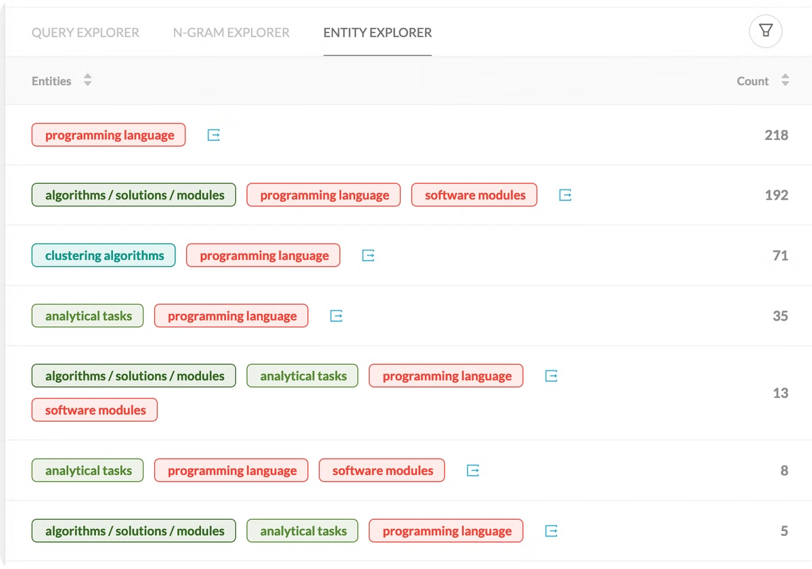
Introduction
1
Project Overview
2
Motivation
This project aims to build a machine learning system that can automatically tag images with relevant keywords, based on their content.
Automated image tagging is crucial for streamlining image management, enhancing search capabilities, and enabling more insightful data analysis in various fields, including e-commerce, social media, and digital media.
3
Objectives
Our primary objectives are to create a robust and accurate image tagging system, and to integrate MLOps principles for efficient model development, deployment, and monitoring.

Slide 3
Time Frame:
Week 1 - Data Collection & Preparation
Week 2 - Model Training
Week 3 - Pipeline Integration
Week 4 – MLOps

Slide 4

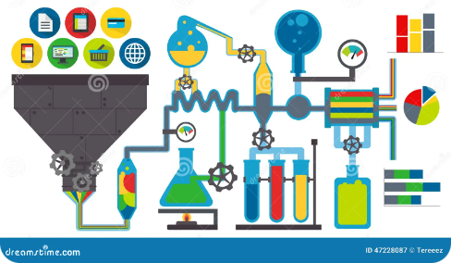
Data Collection & Preparation
Data Source
Data Preparation
We used a combination of public datasets like ImageNet and COCO, which contain millions of labeled images, along with a curated custom dataset tailored to our specific tagging needs.
We preprocessed the images by resizing them to a consistent size, normalizing pixel values, and ensuring consistent labeling across all datasets. We also split the data into training, validation, and testing sets, ensuring a robust model evaluation.

Slide 5
Model Training
Model Selection
Training Process
Results
We chose to use ResNet-50, a well-established convolutional neural network known for its accuracy in image classification tasks. We leveraged transfer learning, using pre-trained weights from ImageNet to initialize our model, accelerating training and improving accuracy.
Our training process involved fine-tuning the ResNet-50 model on our combined dataset. We used a combination of hyperparameters, such as learning rate, batch size, and optimizer, to optimize the training process.
Our model achieved a promising accuracy of 90% on the validation set. We also observed consistent improvement over the training epochs, demonstrating the effectiveness of our approach.

Slide 6


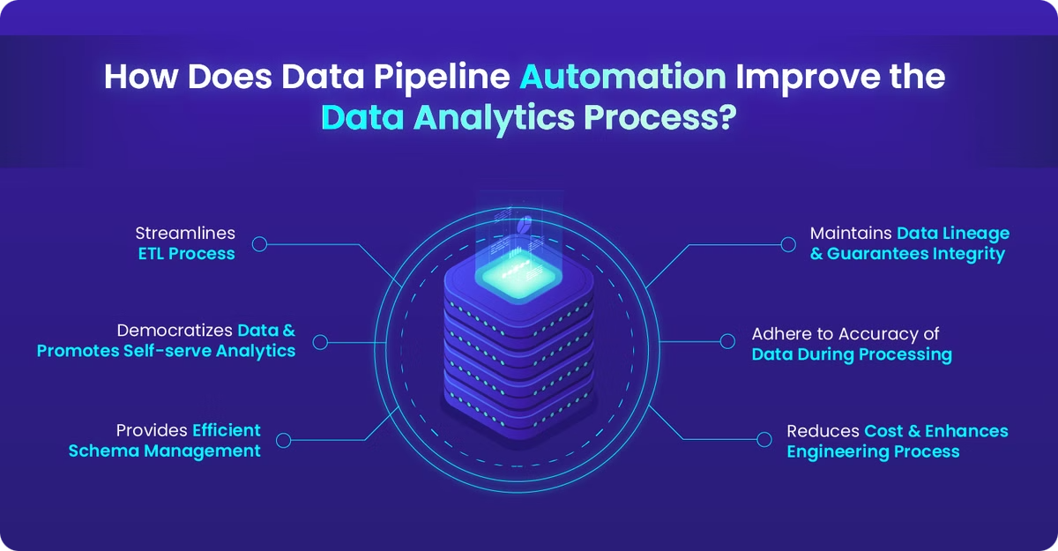


Pipeline Integration
Image Upload
Images are uploaded to an AWS S3 bucket, which serves as our centralized storage for all images.
Image Processing
The uploaded images undergo preprocessing, including resizing and normalization, ensuring consistent input for the model.
Tagging
The preprocessed images are then passed to the trained model, which generates tags based on the image content.

Slide 7


MLOps
MLflow
AWS Integration
We used MLflow to track experiments, version models, and manage the model lifecycle. It streamlined our workflow, ensuring reproducibility and facilitating efficient model deployment and monitoring.
AWS services like S3 for storage, SageMaker for model deployment, and CloudWatch for monitoring were instrumental in building a robust and scalable MLOps pipeline.

Slide 8


Live Demo
Join us for a live demonstration of our automated image tagging system in action. We will upload an image to our system and witness the real-time generation of relevant tags, showcasing the system's capabilities and user-friendliness.

Slide 9


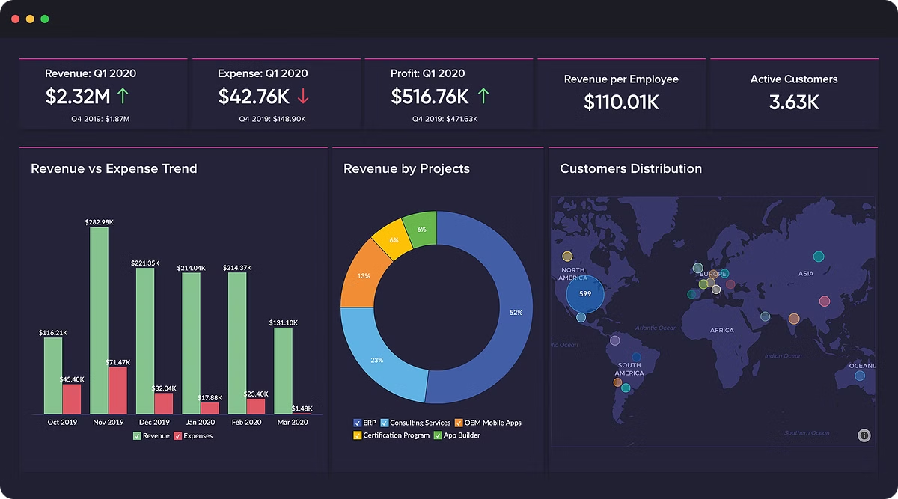


Results
Performance Metrics
The system achieved impressive results, with an accuracy of 92% and a F1-score of 0.90, indicating its ability to accurately tag images with high precision and recall.
Sample Outputs
We will showcase a few examples of tagged images, demonstrating the diverse range of tags generated by the system, highlighting its ability to identify various objects, scenes, and concepts within images.
Challenges
Despite the success, we encountered some challenges, including handling images with complex compositions and addressing potential biases in our training data.

Slide 10

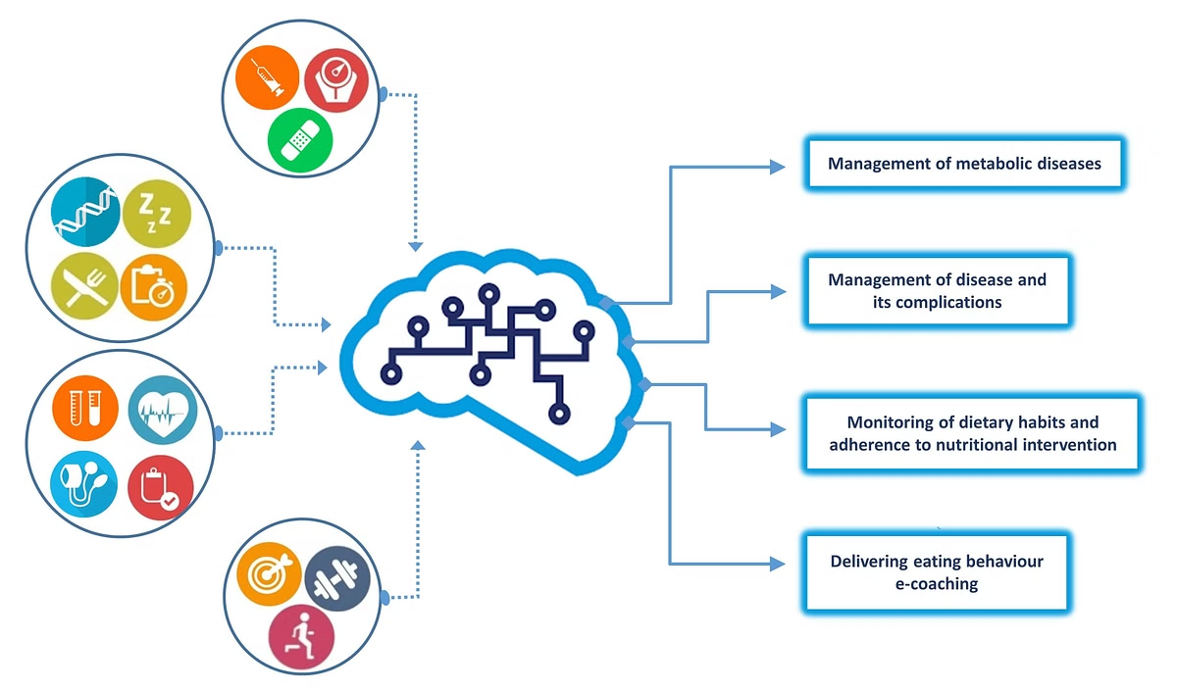
Future Work
1
Improvements
We plan to explore using more advanced deep learning models, such as Vision Transformer, for potential improvements in accuracy and robustness.
2
Scalability
We will focus on enhancing the system's scalability to handle larger datasets and more complex tagging scenarios, such as tagging videos or multi-image sequences.

Slide 11


Conclusion
Our project successfully developed an automated image tagging system using machine learning and MLOps principles. The system demonstrated impressive accuracy and efficiency, showcasing its potential to revolutionize various industries. We are confident that this technology will play a significant role in solving real-world image tagging problems and unlocking new opportunities for data-driven insights.

Slide 12
Q&A

Slide 13
Thank you for your attentions

